Slide 1
T-Mobile’s 600 MHz Deployment
Frequency Coordination & Notification
Houston & San Antonio – September 2018
Spectrum Clearing

Slide 2
What are the results of the FCC’s broadcast spectrum auction?

Slide 3
Auction Results?
T-Mobile: Average of 31 MHz across the USA
        $8 billion of ≈ $20 billion generated in the auction was paid by T-Mobile.
70 MHz
available in each Partial Economic Area
(414 total PEAs
across US)
dish
Comcast
45%
of available spectrum
AT&T
Charlie Townsend
Columbia Capital
Low band spectrum: travels further, penetrates buildings better, means cost-effective coverage across less densely populated areas.

Slide 4
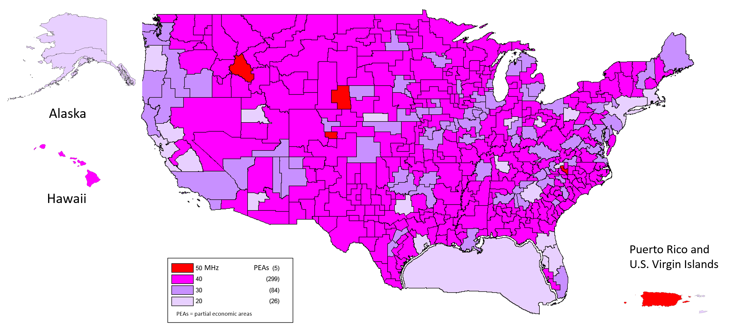
Auction Results for T-Mobile

Slide 5
UHF alignment with new Wireless Band (71)
T-Mobile owns the B, C, D and E blocks in most of Wisconsin and Illinois. In
Urban centers of Milwaukee and Chicago is only B, C, and D blocks

Slide 6


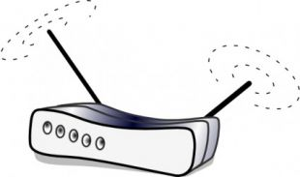

Possible Interference Mechanisms
T-Mobile concerns:
Case 1: WMP on eNodeB
Case 2: WMP on UE
WMP concerns:
Case 3: eNodeB impact on WMP
Case 4: UE uplink on WMP
Uplink
UHF 45-51
Downlink
UHF 38-44
WMP area:
Wireless License Area:
WMP area:
Wireless License Area:
Case 1
Wireless Microphone
Base Station
Wireless Microphone
Base Station
Case 3
Case 2
Case 4
Handset
Handset
WMP Receiver
WMP Receiver

Slide 7
Repack Timeline
2017
2018
2019
2020
2017 Phase 0:
T-Mobile launched 600 MHz deployments in regions where broadcasters are not using the spectrum.
More Phase 0 sites
Working to move stations early
November: Phase 1
April: Phase 2
June: Phase 3
August: Phase 4
September: Phase 5
October: Phase 6
January: Phase 7
March: Phase 8
May: Phase 9
July: Phase 10
Interference
Analysis underway now to protect full power stations.

Slide 8


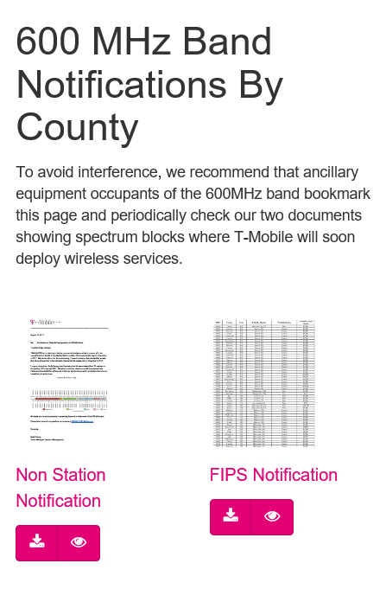
3rd Quarter 2017
600 MHz Spectrum Videos
4th Quarter 2017
3rd Quarter 2018
HowMobileWorks.com/spectrum

Slide 9
The Un-carrier.
Thank you.

